Slide 1
Synthesizing realistic audio using generative adversarial networks
Justin Zhang

Slide 2

Dance of the Sugar Plum Fairy by Pyotr Tchaikovsky
Real recording
MIDI (file format)
~20,000 kB (full song)
(typically) Requires a group of people
Require years of experience with music
~20 kB (full song)
Can be made by one person
Require little to no musical expertise
From free-stock-music.com (https://www.free-stock-music.com/music/tchaikovsky-dance-of-the-sugar-plum-fairy.mp3)
From the University of Arizona MIDI database (public domain) (http://midi.music.arizona.edu/Tschaikowsky/tsch_dspfe_com.mid ) using a leading soundfont
Notes:
The violins in the background are much shorter in the real recording, and the real recording has a noticeably different acoustic setting
The MIDI violins sound copy-pasted
Older people might remember how MIDI files were more common, mainly due to this smaller file size
FROM WRITER: Explain differences (violin staccatos, bells being more vibrant in real recording (MIDI bells seemed to be rushed)

Slide 3
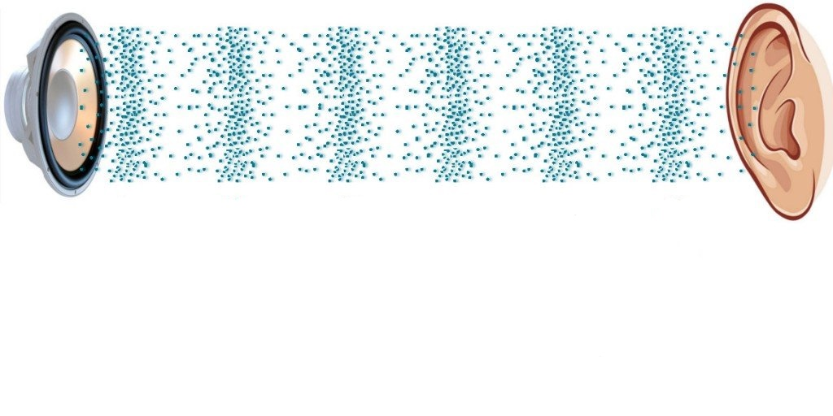
Audio
https://www.scienceabc.com/wp-content/uploads/2017/11/Sound-waves-coming-from-speaker-to-ear.webp

Slide 4
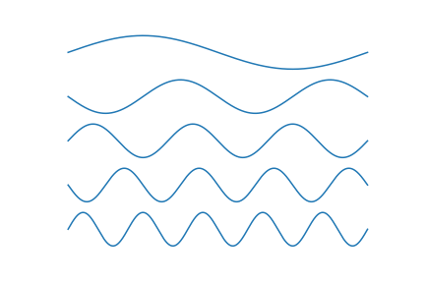
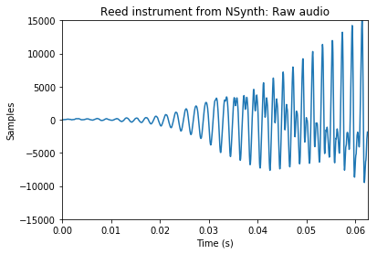
Fast Fourier transform
Generated from the NSynth dataset, Engel et al. (2017), https://magenta.tensorflow.org/datasets/nsynth
Notes:
The Fourier transform separates out a wave signal into these sine waves
Any wave signal can be represented as different sine waves

Slide 5
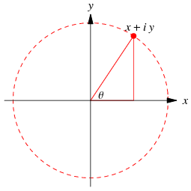
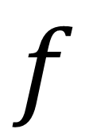
Fast Fourier transform
$$f$$
From Wolfram Alpha (http://mathworld.wolfram.com/images/eps-gif/ComplexNumberArgand_1000.gif)
Notes:
For example, this sawtooth wave can be deconstructed as an infinite series of sine waves
Given a frequency and a time period, the Fourier transform outputs a complex number
FROM SOMEONE: describe inputs and outputs of Fourier transform, maybe with pictures

Slide 6
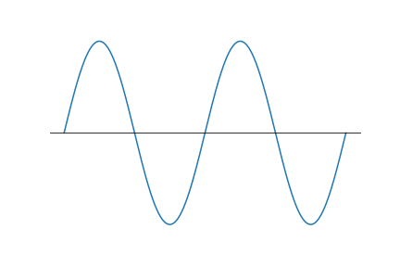
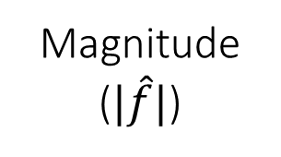
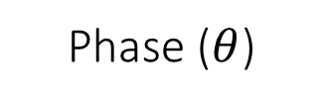
Phase ($θ$)
Magnitude ($|\hat{f}|$)
From Wolfram Alpha (http://mathworld.wolfram.com/images/eps-gif/ComplexNumberArgand_1000.gif)
Notes:
Need both magnitudes and phases to reconstruct audio
Describe complex numbers well
Transition to discussion about phases

Slide 7

Audio reconstructed without phases
Audio reconstructed with phases
Original audio
From Wolfram Alpha (http://mathworld.wolfram.com/images/eps-gif/ComplexNumberArgand_1000.gif)
Generated from the NSynth dataset, Engel et al. (2017), https://magenta.tensorflow.org/datasets/nsynth
Notes:
Need both magnitudes and phases to reconstruct audio
FROM WRITER AND RONAN: Describe complex numbers better, as point, maybe collab w/ Ayush

Slide 8
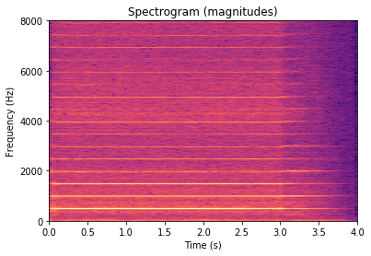
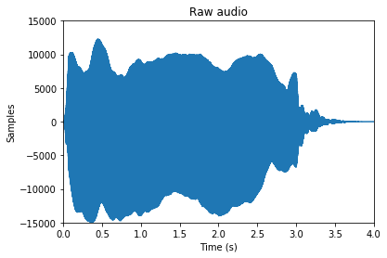
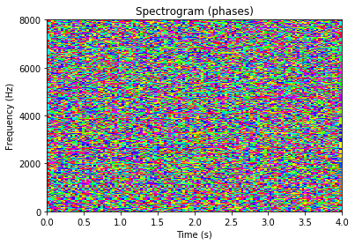
Spectrograms
Generated from the NSynth dataset, Engel et al. (2017), https://magenta.tensorflow.org/datasets/nsynth
Notes:
Spectrograms are just a 2D representation of many Fourier transforms
From Crowe: Spectrograms are just a 2D representation of Fourier series made using the Fast Fourier Transform (FFT), a discretized Fourier transform
Again, this audio is from the dataset I’m going to use
Pixel in spec = small window in audio
If we can generate these spectrograms, then we can make audio
Channels in image like RGB

Slide 9



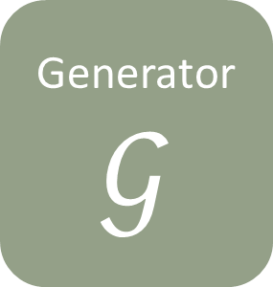
Generative adversarial network (GAN)
Generated picture
Generator
$$𝒢$$
Discriminator
$$𝒟$$
Real or fake?
Training picture
Latent space
Notes:
Make pencil point different places

Slide 10
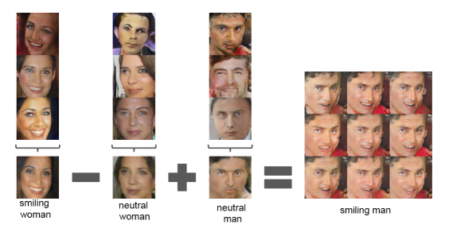

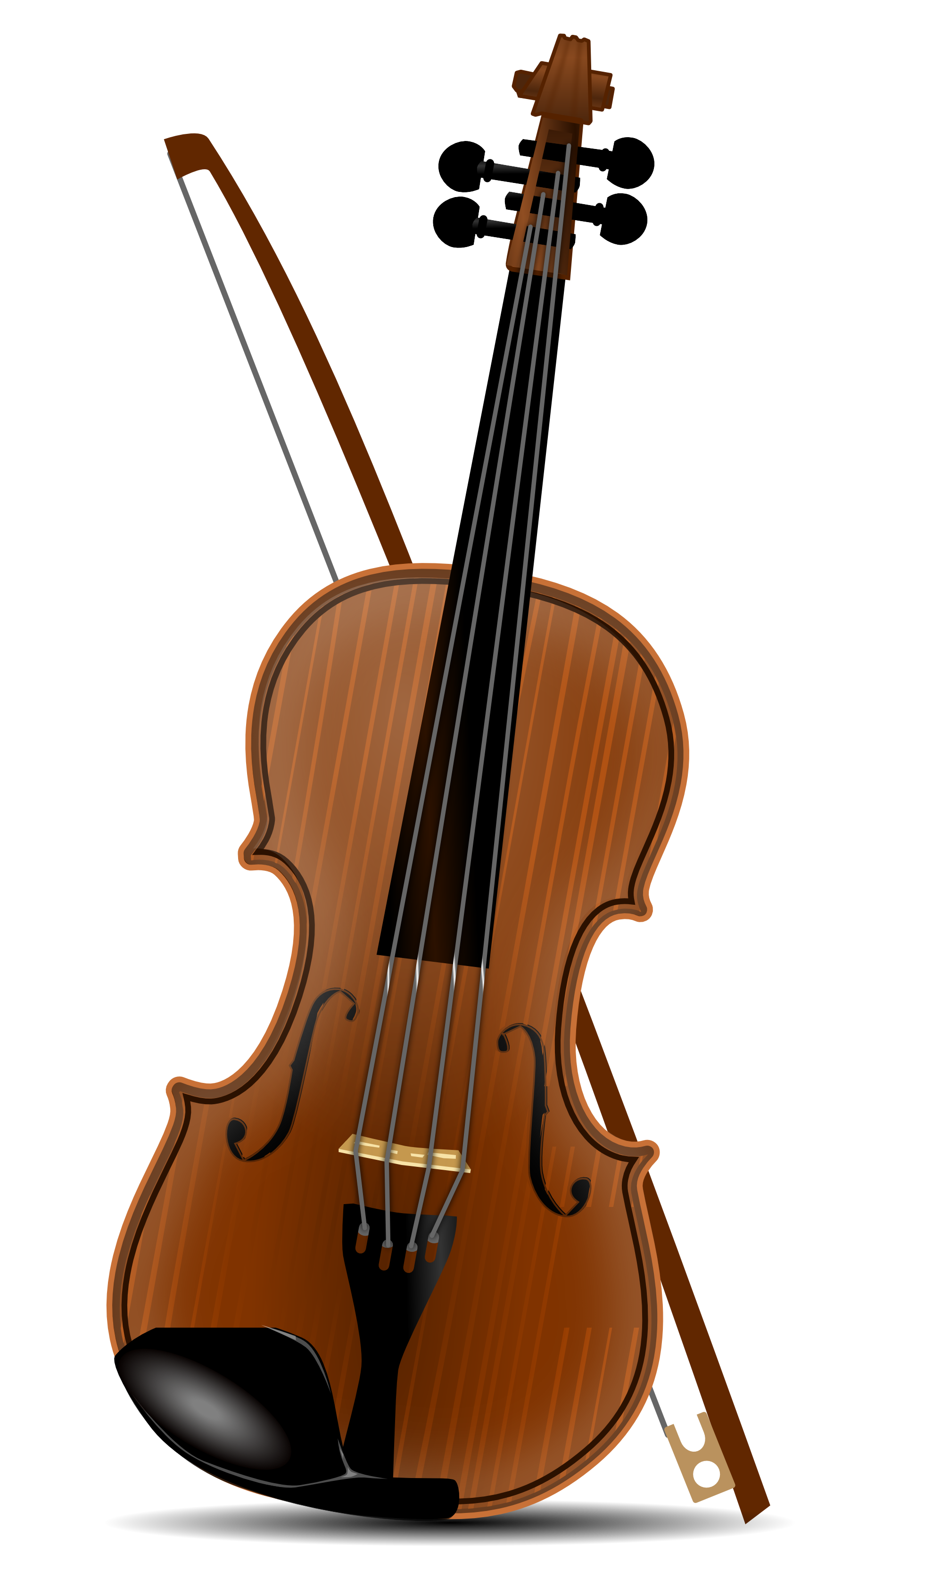
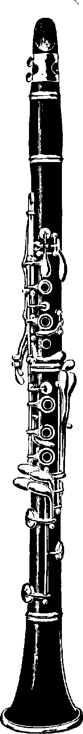
Walking the latent space
From Radford, Metz, and Chintala (2016)
Eagletone Clarinet, https://www.amazon.fr/Clarinettes-EAGLETONE-ROAD-CL100-%C3%A9tude/dp/B01ET4G64G
From clipartpanda.com, http://images.clipartpanda.com/violin-clip-art-60018-lip_art_clipart_coloring_book_colouring-1979px.png
Notes:
It’s a way to more be able to more granularly control output of generator

Slide 11
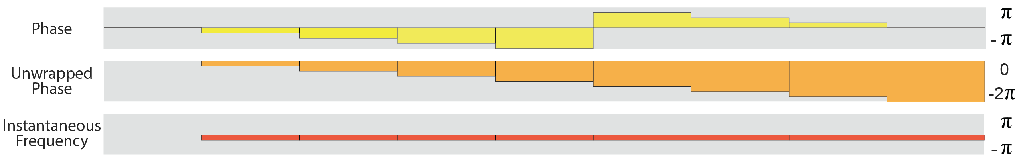
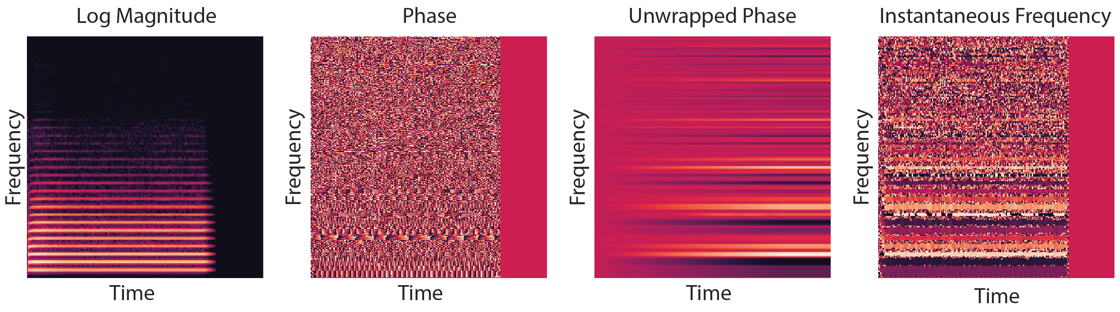
GANSynth
Engel et al. (2019)

Slide 12
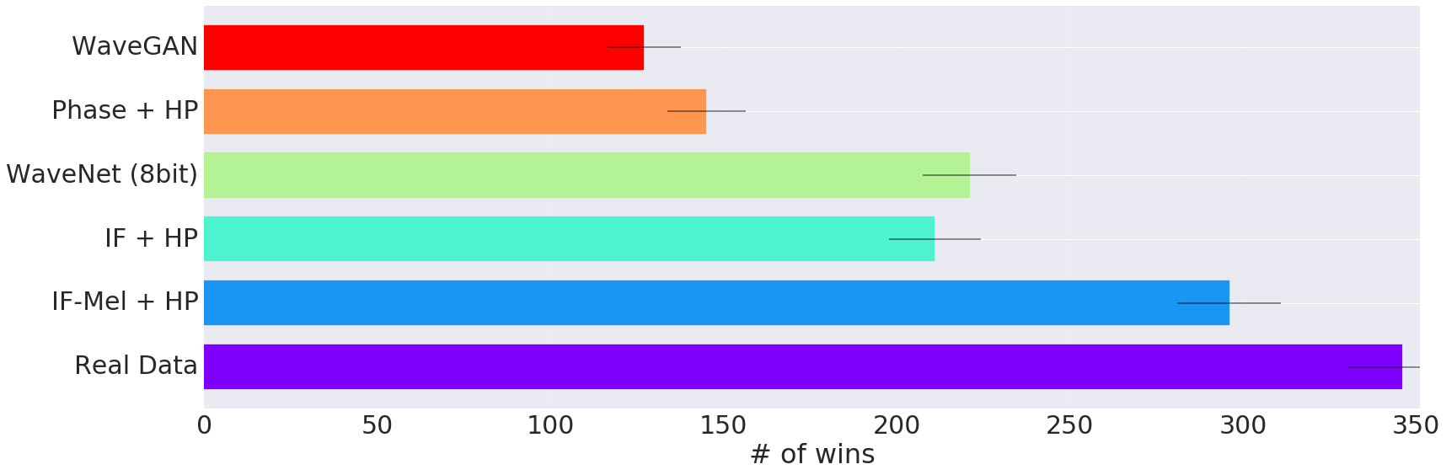
GANSynth
Engel et al. (2019)

Slide 13
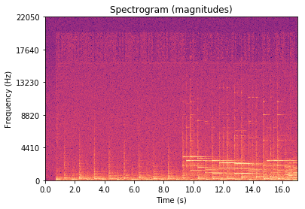
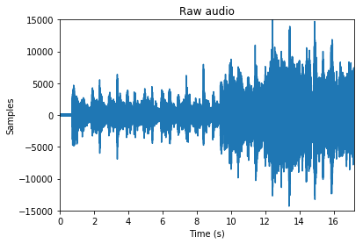


New Idea
$𝒢$
$𝒟$
Phase 1: Training GAN
Audio waveform graphed and generated spectrogram is Dance of the Sugar Plum Fairy from free-stock-music.com

Slide 14

New Idea
$𝒢$
Phase 2: Latent space dataset
Audio waveform graphed and generated spectrogram is Dance of the Sugar Plum Fairy from free-stock-music.com
Notes:
Encoding

Slide 15
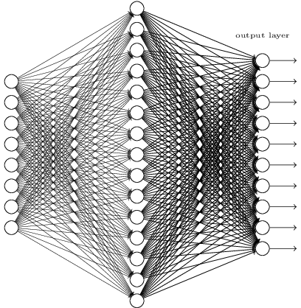
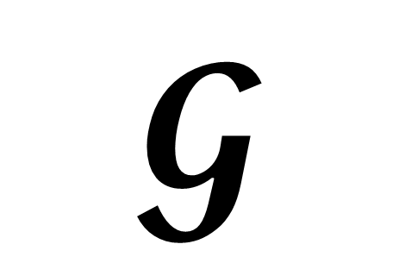
Reconstructing latent space
$$𝓖$$
Latent space
From Michael Neilsen’s book at http://neuralnetworksanddeeplearning.com/
Backpropagation

Slide 16

New Idea
RNN
$𝒢$
Phase 3: Generation
Audio waveform graphed and generated spectrogram is Dance of the Sugar Plum Fairy from free-stock-music.com

Slide 17
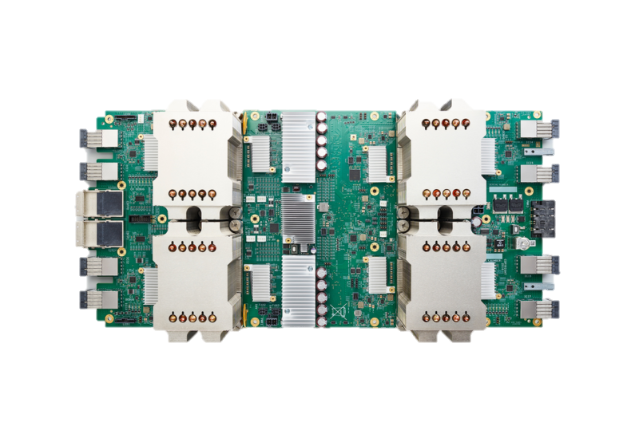
Progress
TPU

Slide 18
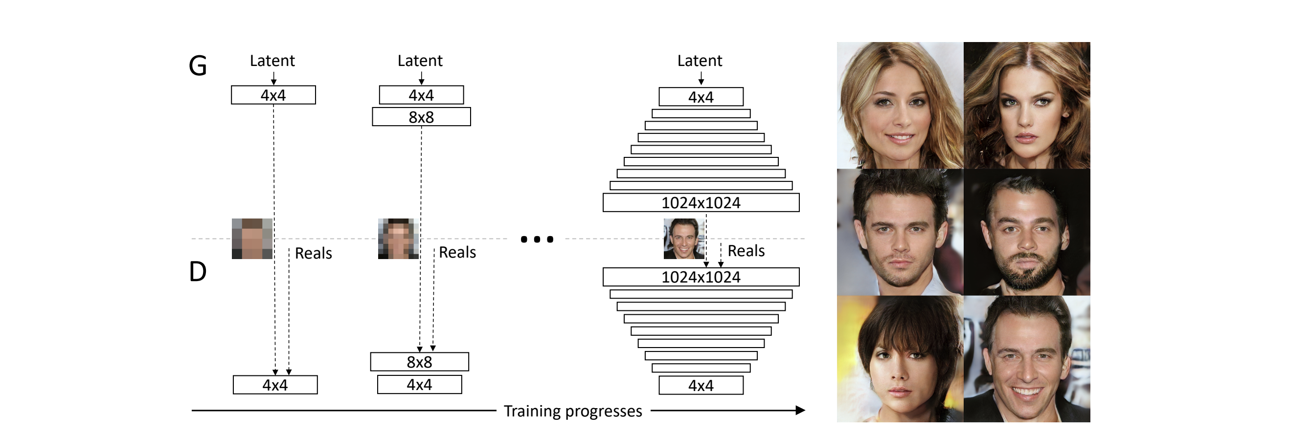
Progressive GAN
Karras et al. (2017)

Slide 19
References
Choi, K., Fazekas, G., Sandler, M., & Kyunghynn, C. (2017). Convolutional recurrent neural networks for music classification. ICASSP. doi:10.1109/ICASSP.2017.7952585, arXiv:1609.04243v3 [cs.NE]
Costa, Y. M. G., Oliveira, L. S., & Silla, C.N., Jr. (2017). An evaluation of convolutional nerual networks for music classification using spectrograms. Applied Soft Computing, 52(1), pp 28-38. doi:10.1016/j.asoc.2016.12.024
Creswell, A., White, T., Dumoulin, V., Arulkumaran, K., Sengupta, B., & Bharath, A. A. (2017). Generative adversarial networks: An overview. IEEE Signal Processing Magazine, 35(1), pp. 53-65. doi:10.1109/MSP.2017.2765202, arXiv:1710.07035v1 [cs.CV]
Donahue, C., McAuley, J., & Puckette, M. (2018). Adversarial Audio Synthesis.
Engel, Jesse, et al. "Gansynth: Adversarial neural audio synthesis." arXiv preprint arXiv:1902.08710 (2019).
Engel, J., Resnick, C., Roberts, A., Dieleman, S., Eck, D., Simonyan, K., & Norouzi, M. (2017). Neural Audio Synthesis of Musical Notes with WaveNet Autoencoders. CoRR. arXiv:1710.07035 [cs.CV]
Goodfellow, I., Pouget-Abadie, J., Mirza, M., Xu, B., Warde-Farley, D., Ozair, S., … Bengio, Y. (2014). Generative adversarial nets. Advances in Neural Information Processing Systems, 27, pp. 2672–2680. arXiv:1406.2661 [stat.ML]

Slide 20
References (cont.)
Karras, Tero, et al. "Progressive growing of gans for improved quality, stability, and variation." arXiv preprint arXiv:1710.10196 (2017).
Pons, J., Slizovskaia, O., Gong, R., Gómez, E., & Serra, X. (2017). Timbre Analysis of Music Audio Signals with Convolutional Neural Networks. CoRR. arXiv:1703.06697 [cs.SD]
Radford, A., Metz, L., & Chintala, S. (2016). Unsupervised representation learning with deep convolutional generative adversarial networks. ILLR. arXiv:1511.06434 [cs.LG]

Slide 21
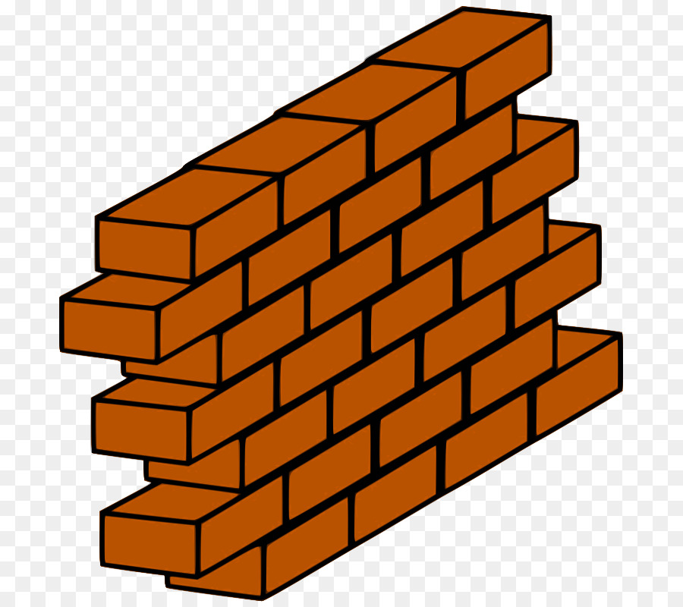
Progress
TPU

Slide 22
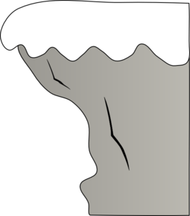
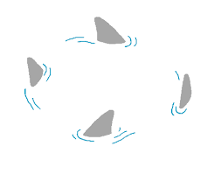
Progress

Slide 23
Media references
Dance of the Sugar Plum Fairy MIDI is from the University of Arizona MIDI database (public domain) using a leading soundfont and from free-stock-music.com; all audio has been rescaled, and figures were made from this audio
The Nsynth datatset and WaveNet autoencoder diagram is from Engel et al. (2017)
Neuron and dense neural network diagrams are from Michael Nielsen’s “Neural Networks and Deep Learning,” licensed under a Creative Commons Attribution-NonCommercial 3.0 Unported License.
Loss curve diagram is from rasbt.github.io
Using Convolutional Neural Network for Determining Reticulocyte Percentage in Cats - Scientific Figure on ResearchGate. Available from: https://www.researchgate.net/figure/Convolutional-neural-network-LeNet-5-from-LeCun-et-al-4_fig1_323747175 [accessed 2 Dec, 2018].
Single convolution GIF is from https://github.com/vdumoulin/conv_arithmetic Accompanying paper is at arXiv:1603.07285v1 [stat.ML]
Non-GIF CNN diagrams were as seen in and as cited by “An intuitive guide to Convolutional Neural Networks” by Daphne Cornelisse
Autoencoder diagram is from Prof. Seungchul Lee’s GitHub: http://i-systems.github.io/HSE545/machine%20learning%20all/Workshop/CAE/06_CAE_Autoencoder.html
Walking the latent space diagram is from Radford, Metz, & Chintala (2016)
Violin in latent space slide is from clipart-library.com, clarinet is from dumielauxepices.net
All graphs were created by me in MatPlotLib
Notes:
Make better citations

Slide 24
Things to fix (from 1st quarter, now outdated
MORE PICTURES, LESS WORDS (at least 2 pics per slide, don’t do it by words if you can picture)
Axes on spectrograms, label
Better bridges/connecting each slide to the next
More color contrast in workflow
Better hook
Key for workflow
Two audio side by side for midi
Audio for spectrogram without phases
Justification for project, both now and final goal
Real life application
Which part of slides go under workflow
Cite Medium.com workflow
Label diagrams better (axes on spectrogram, title of vaes and gans)
Elaborate on classification vs generation, maybe remove that slide or expand that slide
Could connect to imputation, need better bridge from previous slide to that one
Connect VAEs and GANs: encoder and generator parallel, how latent spaces connect

Slide 25
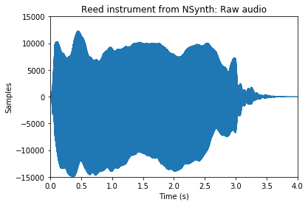
Raw audio
Generated from the NSynth dataset, Engel et al. (2017), https://magenta.tensorflow.org/datasets/nsynth
Notes:
This is what audio looks like
A microphone detects the air pressure
I didn’t use the audio for the recording because it was a bit noisy
This audio is from the dataset of small audio files I’ll be using, which I’ll describe a bit more later.
Zoomed in raw audio has three waves:
one very short
one being very long
one somewhere in between
There’s actually a way to quantify this “waviness.”

Slide 26
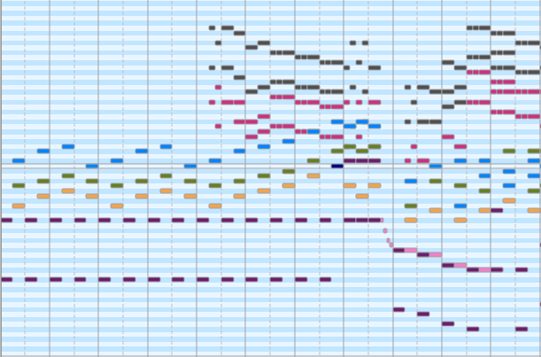
MIDI files
Picture from MIDIEditor view of the Dance of the Sugar Plum Fairy MIDI file from the University of Arizona used earlier
Notes:
Playback is generated by copying and pasting audio snippets
Lists of commands to play THIS INSTRUMENT at THIS TIME for THIS LONG at THIS PITCH THIS LOUD
FROM MATTHEW: compare this representation to real audio
Connect to Can MIDI files sound good?

Slide 27

Fourier transform
Notes:
For example, this sawtooth wave can be deconstructed as an infinite series of sine waves
Given a frequency and a time period, the Fourier transform outputs a complex number
Reason arrow goes both ways is that the Fourier transform can be inverted
FROM SOMEONE: describe inputs and outputs of Fourier transform, maybe with pictures

Slide 28
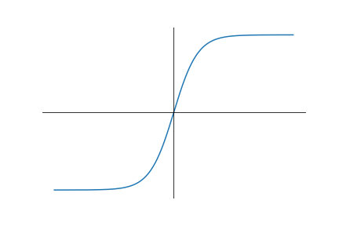
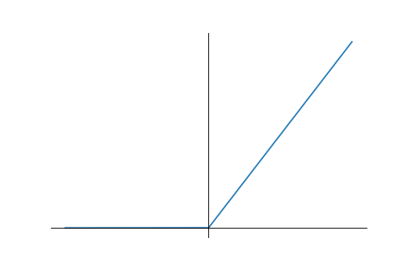
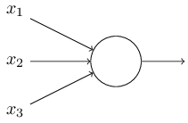
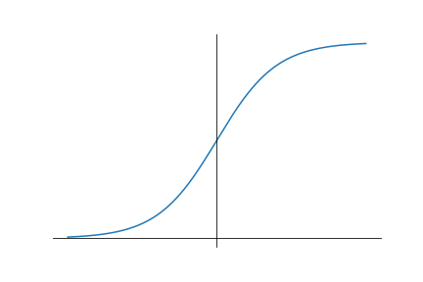
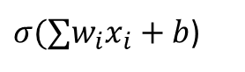




Neural networks (NNs)
$$w_{1}$$
$$b$$
$σ(∑w_{i}x_{i}+b$)
$$w_{2}$$
$$w_{3}$$
Neuron
From Michael Neilsen’s book at http://neuralnetworksanddeeplearning.com/
Notes:
This is a single neuron

Slide 29
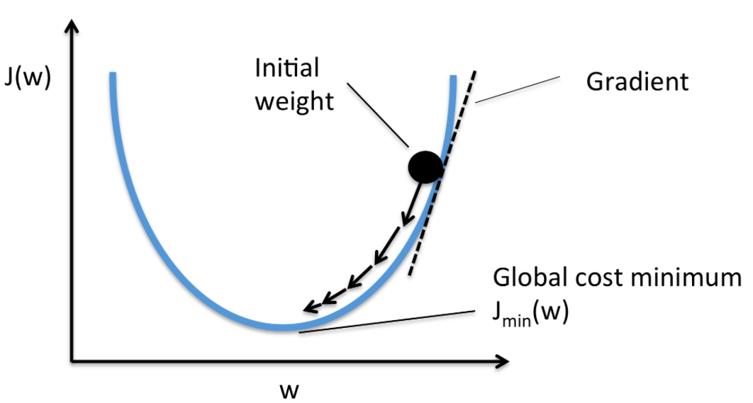
Neural networks (NNs)
Cost function
From Rasbt’s GitHub for gradient descent visualizations, https://rasbt.github.io/mlxtend/user_guide/general_concepts/gradient-optimization/
From Michael Neilsen’s book at http://neuralnetworksanddeeplearning.com/
Backpropagation
Notes:
Activation functions
Cost function
Backpropagation
Model learns itself
Generalization
Transition into why GANs and not just NN for generation:
Different image each time
New image

Slide 30
Generative models
Classification vs generation
Variational autoencoders (VAEs)
Generative adversarial networks (GANs)
Notes:
Classifying: training data is mapped inputs and outputs
Generating: machine tries to generate new images that would seem plausible; no obvious error or cost function to train to optimize
STILL FROM DEORAH AND WRITER: add picture, a slide with no text is a dead slide

Slide 31
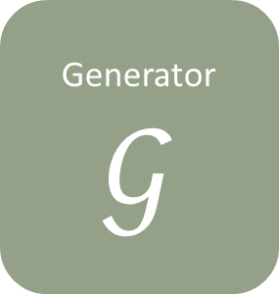

Generative adversarial network (GAN)
Generated picture
Generator
$$𝒢$$
Discriminator
$$𝒟$$
Real or fake?
Training picture
Latent space
Notes:
Why GAN over VAE?
Cost function less direct, better generalization
FROM SOMEONE: Differentiate b/w latent space in VAE
Make pencil point different places
Mention dimensions in latent space
Connect VAE GAN and latent space

Slide 32
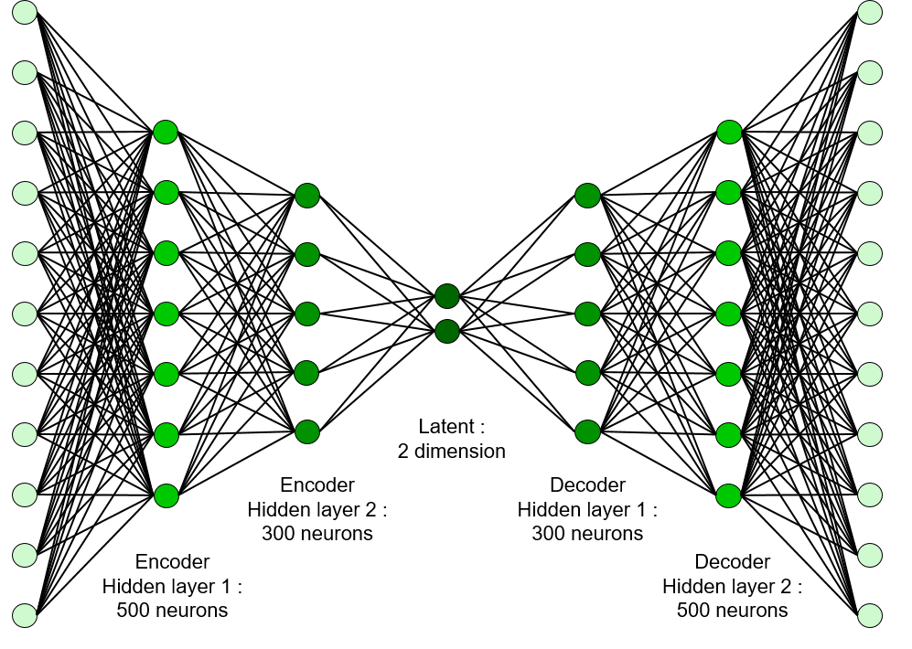
Variational autoencoder (VAE)
Encoder
Decoder
Notes:
Why GAN over VAE?
Cost function less direct, better generalization
FROM SOMEONE: Differentiate b/w latent space in VAE
Make pencil point different places
Mention dimensions in latent space

Slide 33
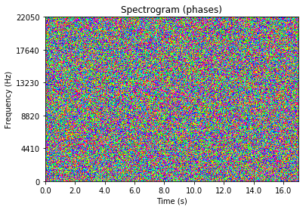
Actual recording
Notes:
Audio is stored as samples, so it’s hard to model directly using anything
Sample rate
Diaphragm
Spectrograms
Pitch
Initiation
Sustaining
Decay
Connecting with other notes
Timbre

Slide 34
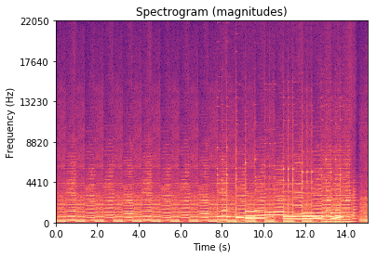
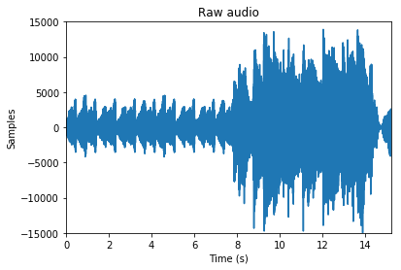
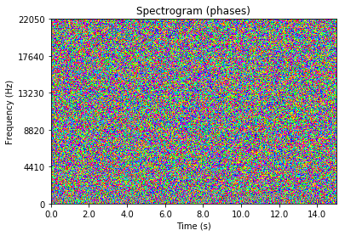
Audio from MIDI
Notes:
Right now thinking why spectrograms and not directly audio?
Spectrograms summarize audio, and classification of audio using spectrograms has been effective

Slide 35

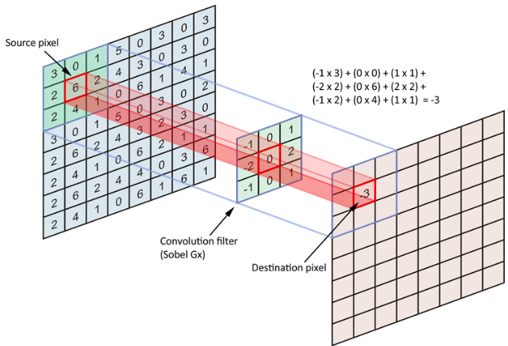
Convolutional Neural Networks (CNNs)
Notes:
Same weights and biases for the whole image
Fewer parameters
Faster training
More accurate modeling

Slide 36
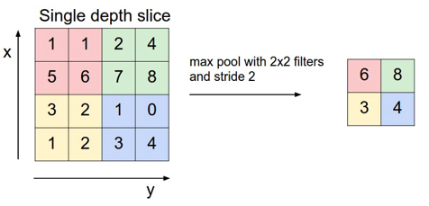

Notes:
Why are CNNs good for images
FROM WRITER: Make metaphors to explain hidden layer learning, Medium article

Slide 37

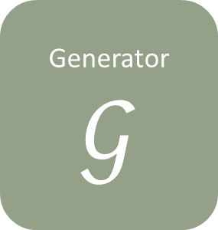

Generative adversarial network (GAN)
Generated picture
Generator
$$𝒢$$
Discriminator
$$𝒟$$
Real or fake?
Deep convolutional GANs (DCGANs)
Wasserstein GANs (WGANs)
Training picture
Latent space
Notes:
…
Training is notoriously hard
Discriminator optimizes too quickly and doesn’t provide a usable gradient for the generator
WGANs solve discriminator being too powerful
How this applies to initial problem:
MIDI could somehow be represented in the latent space
FROM MATTHEW: how I’m going to use DCGANs and WGAN into “WDCGAN”
FROM RONAN: Contrast vaes and gans and what I’m actually going to use in my project

Slide 38
Collecting data
Generating audio
Testing
Processing data
Key:
Finished
Work in progress
NSynth dataset from Engel et al. (2017)
Generate spectrograms from audio
Generative adversarial network
Listening to audio for quality
Extract phases and magnitudes from complex output
Tweak model hyperparameters
Import data into TensorFlow
Generate audio from spectrograms

Slide 39




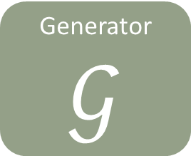
Collecting data
Generating audio
Testing
Processing data
Generator
$$𝒢$$
tensorflow.org
From Wolfram Alpha (http://mathworld.wolfram.com/images/eps-gif/ComplexNumberArgand_1000.gif)
Microsoft icons and http://www.iconarchive.com/show/seo-icons-by-designbolts/Campaign-Tweaking-icon.html
Microsoft icons

Slide 40
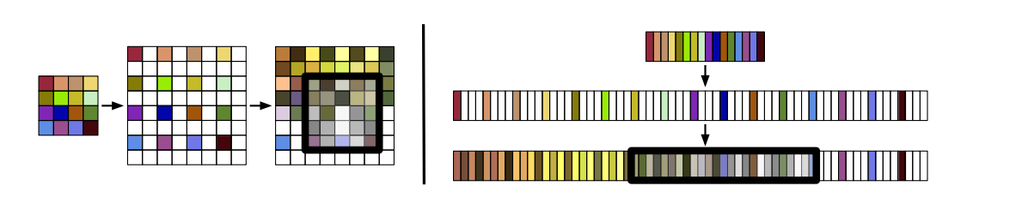
WaveGAN
Donahue, McAuley, & Puckette, (2018).
Notes:
FROM WRITER: connect more from this to my project, differentiate between previous research and this project and purpose
Reemphasize my uniqueness
FROM WRITER: Bring current research more prominently into presentation
Maybe how VAEs connect to this
Read details of paper more

Slide 41
WaveNet
Engel et al. (2017)
Notes:
FROM WRITER: connect more from this to my project, differentiate between previous research and this project and purpose
Reemphasize my uniqueness
FROM WRITER: Bring current research more prominently into presentation
Maybe how VAEs connect to this
Read details of paper more

Slide 42
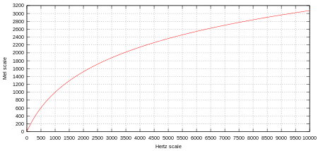
Mel scale
From Wikipedia, File:Mel-Hz plot.svg
From Wikipedia, Raoul NK, Overtones Demo.ogg

Slide 43
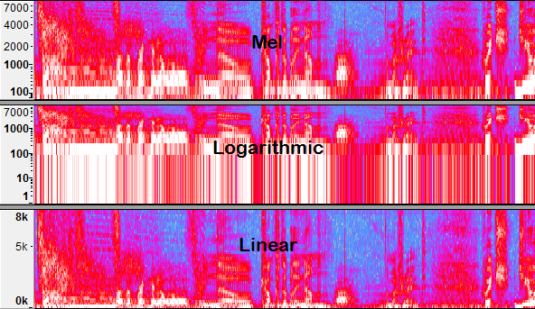
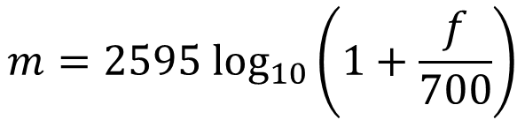
Mel scale
$$m=2595 {\text{log}}_{10}\left(1+\frac{f}{700}\right)$$
From the Audacity team, https://manual.audacityteam.org/man/spectrogram_view.html
Notes:
Classifiers use mel

Slide 44
GANSynth
Notes:
Classifiers use mel

Slide 45
Machine learning
Model learns itself
Can effectively model organic data
Speech recognition and generation
Image classification
Caption generation
Generalization
Notes:
As opposed to handwriting a model, model learns itself
FROM WRITER AND DEORAH: Add a picture, any slide with just text is dead

